Slide 1

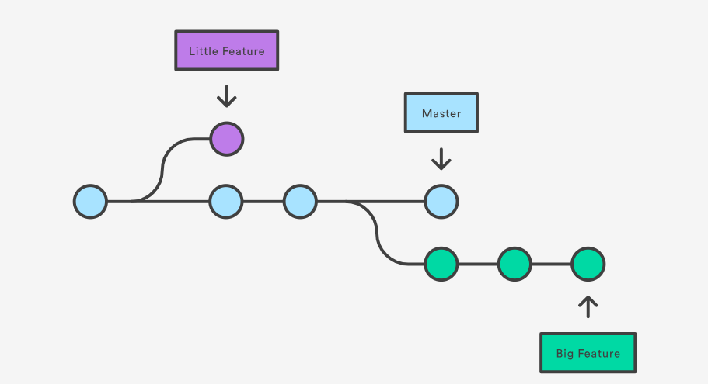
Version Control and Git basics
Prepared by:
- Kevin Patel
- Ravi Shankar

Slide 2
Contents
What and Why Version Control and Git?
Git vs GitHub
Git workflow
Practice.. Practice.. Practice..

Slide 3
What is?
Version control
A system that records changes to a file or set of files over time so that you can recall specific versions later.
A method to store data/files in a central location
A backup when things go wrong
Keeps the history of changes on a central server
Git
A distributed version control system for tracking changes in source code during software development
Designed for coordinating work among programmers, but it can be used to track changes in any set of files.
Everyone has a local copy of the entire work’s history
Notes:
- Disadvantage of a centralized control
- If the main server goes down, then entire project has to pause

Slide 4
Why should we use?
A complete long-term change history of every file.
Branching and merging
Ability to trace each change made
Allows multiple developers to work simultaneously

Slide 5

Git vs Github
Git:
  a version control system that lets you manage and keep track of your source code history.
GitHub:
  a cloud-based hosting service that lets you manage Git repositories.
  If you have open-source projects that use Git, then GitHub is designed to help you better manage them.
  Alternatives: BitBucket, SourceForge, AWS CodeCommit, etc.

Slide 6
Git workflow
Working
directory
add
Staging
Local
repository
push
Remote
repository
commit
restore --staged
fetch
reset <commit id>
pull*
*pull = fetch + merge

Slide 7
Some job posting
Qualcomm
Continental
Aptiv
Porche
Siemens
Outrider

Slide 8

Lets get our hands dirty!!!

